Slide 2
Visual Studio for Mac Tips & Tricks
Amy Burns and Dominic Nahous

Slide 3
What can Visual Studio for Mac do for you?

Slide 4
Build apps, games, and services for mobile, web, desktop, and the cloud.

Slide 5
A brief introduction
A macOS-native IDE
Community, Professional, & Enterprise
Types of projects
.NET Core / ASP.NET Core
Xamarin
Deploy & connect to Azure
Game Development with Unity
Notes:
Visual Studio for Mac is a native macOS application that has the look and feel you'd expect on a Mac! For those of you used to Visual Studio on Windows, we know sometimes this may be be jarring, so where possible we try to be mindful of the differences.
We make things easier for you by providing a single download of Visual Studio for Mac. Once you've installed VSfM, you can activate your existing VS subscription by logging in to the IDE. It's not a problem at all if you don’t have a VS subscription. If you’re eligible, you can use VS for Mac Community for free!
From the File > New Solution menu you can access a variety of new project templates to create .NET Core and ASP.NET Core projects, develop cross platform mobile applications with Xamarin, deploy and connect to Azure and work with Azure Functions, which Amy will talk about later! The last thing I wanted to talk about – and it’s something I’m personally very excited about – is that Visual Studio for Mac is now the official home of Unity on the Mac. So you can develop your Unity games using Visual Studio for Mac.

Slide 6
A technical introduction
C#, F#, HTML/CSS, JavaScript/TypeScript support
Code analysis powered by Roslyn
Unit Testing
MSTest, nUnit, xUnit
Version Control
Git & Subversion
TFVC (currently in preview)
Notes:
Right now with Visual Studio for Mac, we support C# - a language which is commonly used for creating cross platform applications in VSfM - through version 7!
For those of you that prefer strongly-typed functional programming languages, we’re looking out for you too! You have the ability to write and debug in F#
We have editor support for Razor, Javascript, Typescript, HTML and CSS, giving you access to syntax highlighting and IntelliSense if you’re writing for the web!
Speaking of IntelliSense, you’ll be happy to know that IntelliSense, along with the rich set of analyzers, code fixes and refactorings in Visual Studio for Mac are powered by Roslyn, the same engine that drives Visual Studio on Windows.
We all know it’s important to test. For those of you that are more responsible than I am, you’ll be happy to know that Visual Studio for Mac allows you to use VSTest, nUnit, and xUnit to help you maintain health and ensure code coverage.
The last thing for now - you’ll also have the ability to employ version control in your projects, which I’ll talk about a little later!

Slide 7
Take a tour of the IDE with me!

Slide 8
IDE and Editor Preferences
IDE Preferences
Project Options
Policies
Notes:
Okay, so first off there are three kinds of settings you'll want to be aware of when personalizing the IDE in Visual Studio for Mac: IDE prefs, proj options, policies.
IDE Preferences:
- Used to make the IDE function the way you want it. Things like themes and and code folding are IDE preferences. You can adjust these via the preferences dialog
Project options:
- these affect how your app is built so things like build configurations and compiler options are included here. You can get to the project options by right-clicking on your project in the solution pad on the left side of the IDE
Policies:
- These relate to your code styling and formatting. You can adjust these via the preferences dialog

Slide 9
DEMO: Trick out your IDE

Slide 10
Web – ASP.NET Core

Slide 11
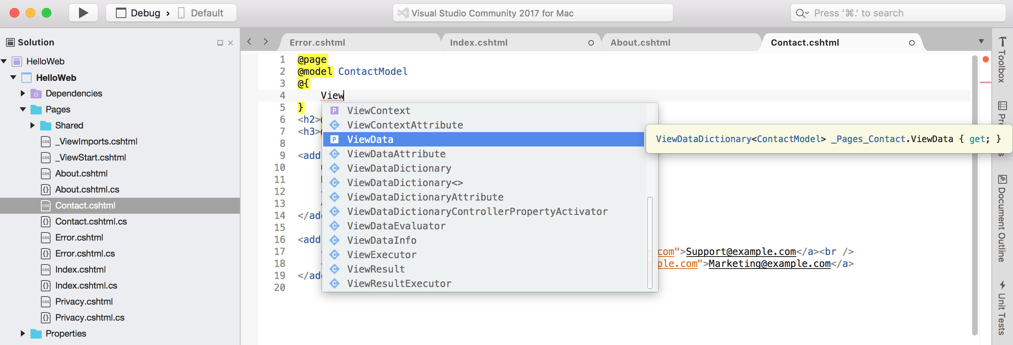
ASP.NET Core
.NET Core 2.1 SDK Support
Razor Language Support (cshtml)
JavaScript
TypeScript
Docker
Notes:
With ASP.NET Core, you can develop awesome, cloud-based, internet connected cross-platform applications. You have the ability to create web apps, services, backends, and you can even hook up your coffee pot to the internet using IoT.
At the moment, Visual Studio for Mac Supports the .NET Core 2.1 SDK.
You’ll be able to create web apps using razor pages or MVC in addition to asp.net web api projects.
Now with this comes intellisense, formatting, and a number of other features for various files including Razor, Typescript, Javascript, CSS, and Html.
You can also hook up with Docker and throw your ASP.NET Core projects into containers!
Last thing for now – I wanted to just indicate that you can configure the location of your .NET Core SDK from the IDE’s preferences page

Slide 12
DEMO

Slide 13
Azure Functions

Slide 14
What are Azure Functions?
A serverless, event-driven, on-demand experience
Easily connects to other Azure services
Easy to get started
Notes:
Azure Functions are a pretty new technology, just over a couple of years old. They're a serverless, event-driven way to get a quick task running (think image or order processing or events that you want to run on a schedule) without the need to build a whole application or infrastructure behind it. You pay only for the time you use and can scale it with Azure.
In addition, Azure Functions tie in with various Azure and 3^{rd party} services like Cosmos DB or Twilio.
There’s a number of different templates available from a Blob Trigger to Github Webhook that allows you to get started quickly with common scenarios.

Slide 15
Azure Functions in Visual Studio for Mac
Supports v2 runtime
.NET Core 2.0+ support
Templates
Local debugging
Publishing!
Notes:
All Of our templates are supported for the the v2 azure functions runtime
We have .net 2.0 support
- Templates available through NPD that you can configure
Deploy certain functions locally
With the newest release, we’re proud to announce that you can now Publish your function to Azure, and we’ll show you this in just a minute.
Visual Studio for Mac now allows you to to create your Azure Function from start to finish, right inside the IDE. Pretty cool, huh!

Slide 16
DEMO

Slide 17
Version Control

Slide 18

Version Control options
TFVC
Support is currently in preview
Available via an extension
Can work with TFS and VSTS repositories
Git (& Subversion)
Built in
Git comes preinstalled
Make sure you have Subversion
Coming soon – Git cloning from within VSTS
Notes:
Right now Visual Studio for Mac supports Team Foundation Version Control (or TFVC, which is what I’ll call it from now on), Git, and Subversion.
TFVC support is currently in preview and can be added in via the gallery tab in the Extension manager. You can access the extension manager via the extension menu item in the the Visual Studio section of the menu bar.
Once you’ve installed it, make sure you restart Visual Studio for Mac. As the extension is in preview, we’re making frequent updates so keep it up to date by checking the updates tab in the extension manager periodically.
With the extension installed, you’ll be able to connect to TFS and VSTS repositories, create workspaces, navigate projects, and perform all the basic source control actions you’re used to.
Let’s move over to talk about Git and Subversion. Support for working with projects under Git and Subuversion version control is built into Visual Studio for Mac. The Version Control menu item will be your best friend when working with these options. You should note that Git is installed on your Mac out of the box. However, I’d advise giving that an update to make sure you’re on a recent version. Now that we’ve got that out of the way, you can hook up to Git repositories to enable pushing, pulling, and all the other good things you’d want to do when collaborating with others (or with yourself). Similarly, with Subversion, you’ll be able to connect to a repository, check out, update, and commit items back to the source. One important thing to note is that Subversion itself does not come installed on Macs. You’ll want to ensure you have that installed before using the feature in Visual Studio for Mac. One easy way to get it is by installing the Xcode command line tools.
You may be familiar with being ability to clone Git repos to VS2017 right from VSTS. We’re working on enabling this ability from VSfM as well! Stay tuned!

Slide 19
Further Information

Slide 20
Visual Studio for Mac updates and Previews
Numerous channels that can be used to get latest and greatest content
Stable
Beta
Alpha
Dynamic Channels
Update Notifications
Notes:
Stable – Ready for production
Beta – Latest Preview. This is updated every couple of weeks. You can see information on what’s in this channel at aka.ms/vsmac-preview-release-notes
Alpha – Weekly builds of exactly what we’ve been working on. This release is not classed as “content ready”.
Dynamic Channels – a way to provide special SDK or specific builds eg. Xcode 10
When new updates are available, you’ll be prompted to download them by the updater dialog. There will also be a notification in the tool bar.

Slide 21
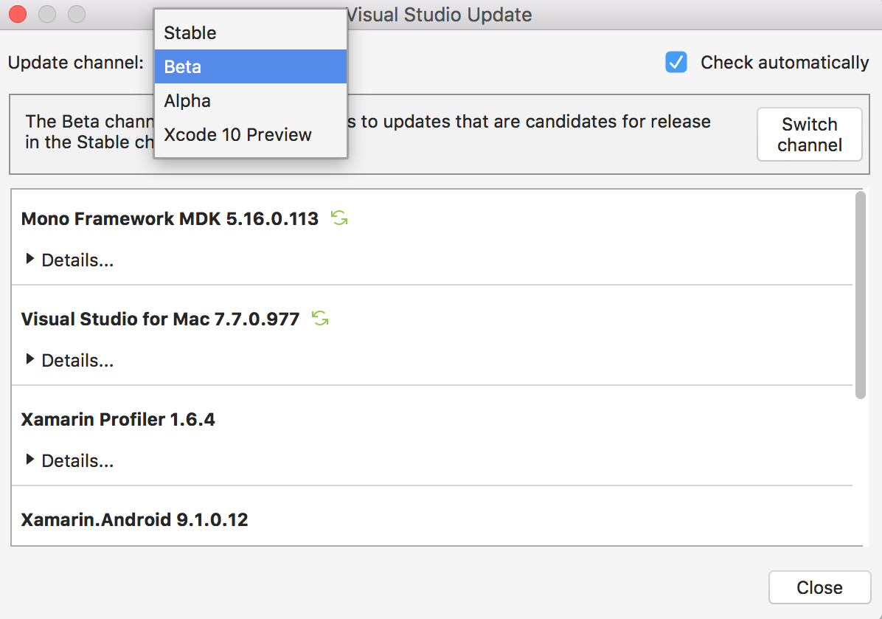
Updating Visual Studio for Mac

Slide 22
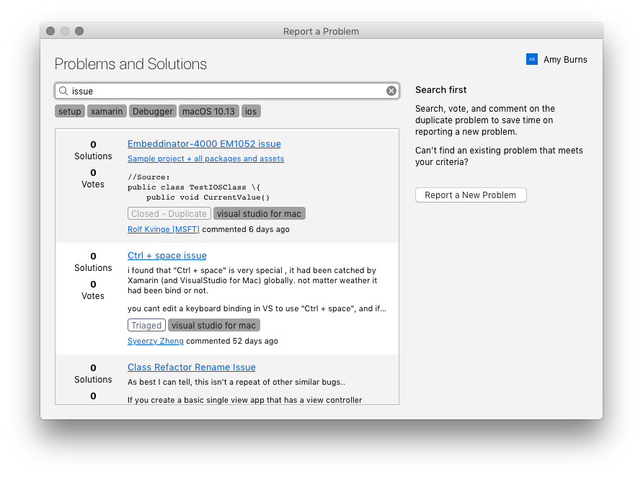
Report a Problem
Notes:
New feature in the latest release (7.6.4)
From this dialog you can browse your followed issues, search for similar issues, or report a new problem

Slide 23
Thank you!!
aka.ms/vsmac​
aka.ms/vsmac-docs
Amy: @timeyoutakeit
Dom: @xamadom

